Slide 1



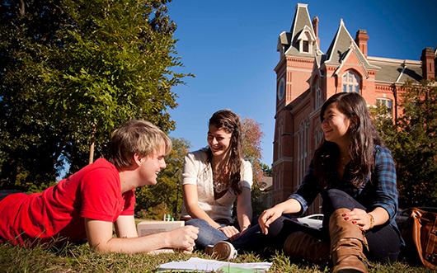

Slide 2

My Future
Our aim:
to sum up the information that we have learnt while working with this module

Slide 3

Ех.1, р. 136
Answer Key
1 attend
2 triumph
3 longs
4 dreamt up
5 overcame
6 worth
7 rejected
8 meagre
9 achieve
10 drop out

Slide 4

Ех.2,3, р. 136
Ex. 2
1 will go 6 would have done
2 will take 7 were
3 would have applied 8 could have gone
4 would revise 9 hadn’t spent
5 is not 10 had got
Ex.3
1 I were you, I would 4 done if you hadn’t
2 wish he hadn’t failed 5 ’d rather we went
3 he would have got

